Slide 1
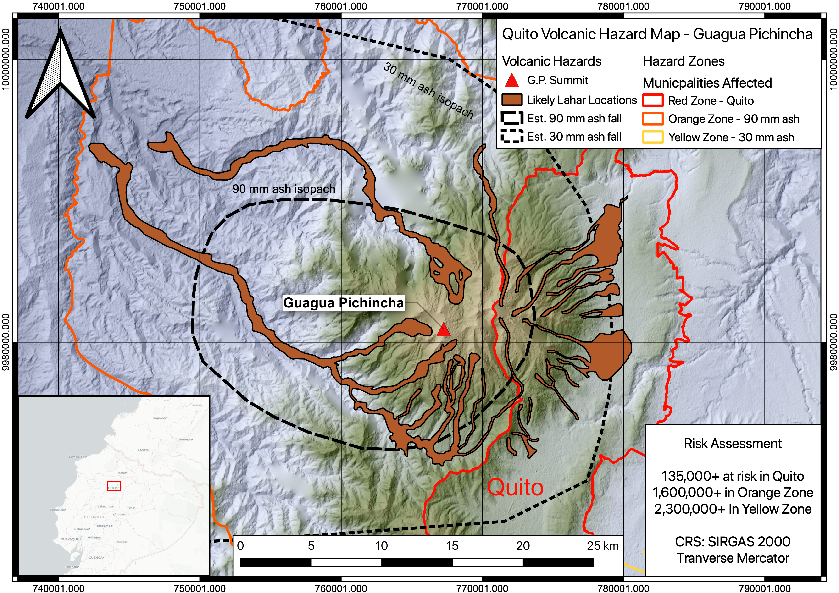
GIS For Dummies Session 2: Live Demo
Presented by Nicholas Barber, 2nd Year PhD Student at the University of Cambridge, U.K.
ndb38@cam.ac.uk | www.volcannick.com | https://github.com/ndb38 | Twitter @volcannick

Slide 2
Workshop Structure
Today: Session 1 – Principles and Motivation for GIS in the Geosciences
Why GIS?
Principles of GIS
Getting acquainted with Quantum GIS?
Wednesday June 17th: Session 2 – Tutorial + Guagua Pichincha Exercise
Tour of Interface
Tutorial
Monday June 29th: Session 3 (GIS for the Intrepid) - Advanced GIS
Frontiers of GIS
Geostatistics
Python
Data Management
Advanced formatting
Wednesday July 1st: Scheduled “TA Hours” for 1-on-1 project advice

Slide 3
Refresher on Interface
Queuing up plugins we'll need, refamiliarizing ourselves with the interface

Slide 4
Textbook Info to Come

Slide 5
Outline of today’s demonstration
Planning a project
Finding Data
Defining CRS/PCS
Initial Import + Projection
Georeferencing Images
Tracing Basemaps
Analysis: Geoprocessing, Statistics, Attributes
Visualization and Symbology
Layout Design

Slide 6
Making a Plan

Slide 7
Planning a QGIS Project
Need to think critically about where GIS fits in to your workflow
A few questions to ask yourself:
What stage of my project am I in? And what value would GIS analyses add at different stages?
E.g., in the planning stage, you might want a map and some prospect sites for outcrops. But in the analysis stage, you might want some specific spatial information about your study site
What question am I trying to answer?
Can this question be answered through other means?
Is there data available for this? (short answer: YES)
More important question: Where is the data I need??
What steps do I need to take to answer this question?
What coordinate/projection system should I use?
How am I going to organize my data?

Slide 8
Our Exercise Today
Focusing on Guagua Pichincha (GP), an active volcano adjacent to Ecuador’s capitol, Quito in the Andes
Our question: How many people are at risk of exposure to the different eruptive products of Guagua Pichincha Quito?
This question encompasses two hazards: 1) lahars (volcanic mudflows) and 2) ash fall
I selected this question for a few reasons:
Require datasets that are readily accessibly
Results verifiable based on previous research
Analyses straightforward, but encompass the crucial “GIS Toolkit” you’ll get out of this course

Slide 9
Our Exercise Today
Structure today:
Live Demo will showcase tools and parameters needed to answer this question
Will be accompanied by discussions with these slides
IN DEVELOPMENT: By the end of the four-part workshop, I’ll create detailed guides in PDF format, describing this exercise workflow step by step.
Skills you will get out of this exercise: project design, data sourcing, projecting vector and raster data, importing data, setting up interface, file management, basic vector analysis, attribute table calculations, spatial statistics, georeferencing, creating new features, symbology + visualization, layout management.
Next time we will use G.P. and this region of Ecuador for some more advanced statistical and analytical procedures
WILL ASK CAT TO SOLICIT FEEDBACK AFTER THIS WEEK

Slide 10
Finding Data

Slide 11
Where in the world do I find data?
Think in detail about our question: what do we need to have?
Information on volcano
Geology
Estimated hazards
Location
Severity
Geochemistry/Geophysics?
Information on surrounding population
Infrastructure?
Hydrology
Municipal boundaries
Location of Major population centers
Population #
Demography?
Information on topography

Slide 12
Where in the world do I find data?
Think in detail about our question: what do we need to have?
Information on volcano
Geology
Estimated hazards
Location
Severity
Geochemistry/Geophysics?
Information on surrounding population
Infrastructure?
Hydrology
Municipal boundaries
Location of Major population centers
Population #
Demography?
Information on topography

Slide 13
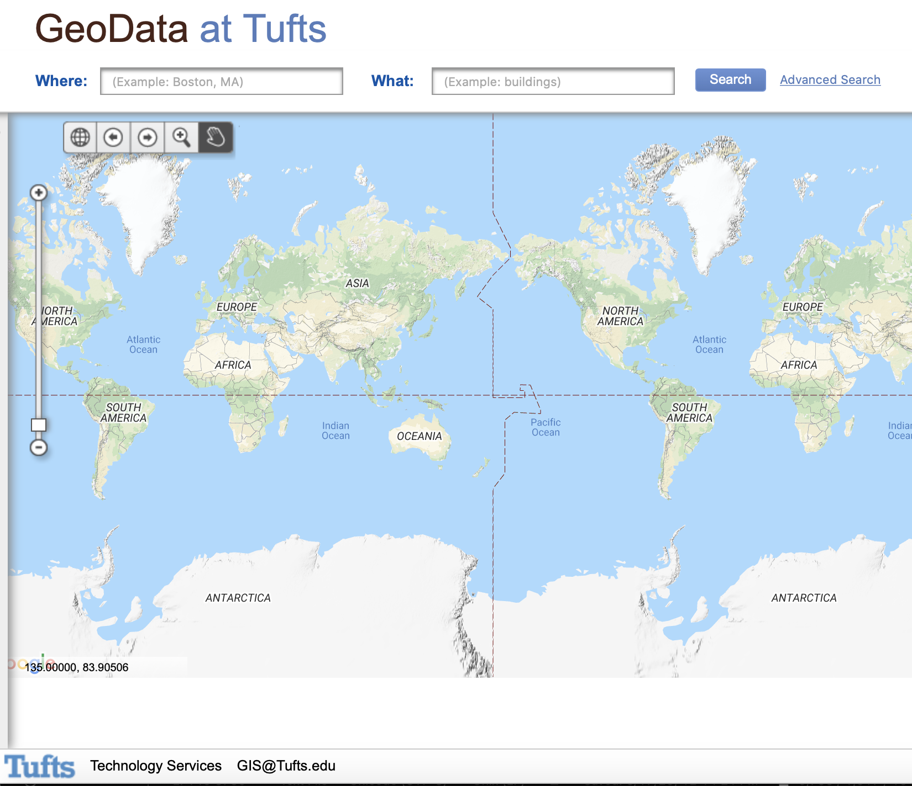
Generic Datasets (Example): https://geodata.tufts.edu

Slide 14
Other Data Sources
Economic Geology: https://mrdata.usgs.gov/general/map-global.html
Similar generic info: http://hgl.harvard.edu:8080/opengeoportal/
Humanitarian/land use data: https://geoportal.landportal.org/?gclid=CjwKCAjw_qb3BRAVEiwAvwq6Vgusj8dZX1TuJTa3ipj7r6hEaFvMbdN-ZZJ2ekZ8iNdt-FZZJnmMHhoCAWUQAvD_BwE
USGS Earth Explorer: https://earthexplorer.usgs.gov
ESRI Hub: https://hub.arcgis.com/search
Natural Earth: http://www.naturalearthdata.com/downloads/
NASA Socioeconomic data: https://sedac.ciesin.columbia.edu
LIDAR Data: https://opentopography.org
UN Data: http://geodata.grid.unep.ch
Pop and Enviro Data: https://terra.ipums.org

Slide 15
Deciding on Coordinates and Projections

Slide 16
Importing + Reprojecting Data

Slide 17
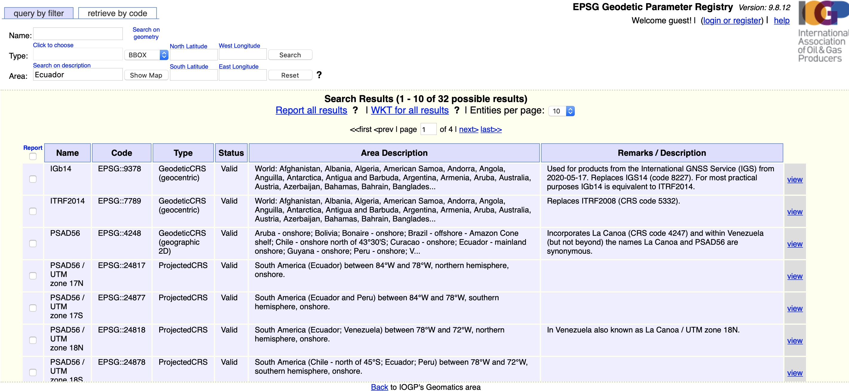
We want something that’s accurate for our study area
Datum itself isn’t that important – one of the most common is GRS80
We want a Latin American projection system, localized in Ecuador

Slide 18
Importing Data
Format: SHP, GPKG, GeoTiff
Which layers to keep?
Renaming and resaving
Data specific tasks:
Vector Data: Metadata
Elevation data: Close Gaps + Hillshade
CSV: Import
Reprojection

Slide 19
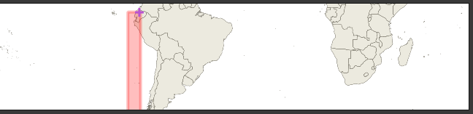
SIRGAS 2000/UTM Zone 17S
We are just in bounds of 1.0m accuracy SIRGAS 2000/17S
EPSG 31977
Note: not the only choice we could make! There are many possibly options
Decision based on locality (always better to fit with a projection suited to your part of the geoid) and widespread use – SIRGAS 2000 a standard CRS for South America

Slide 20
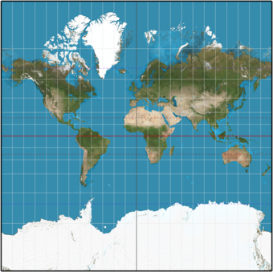
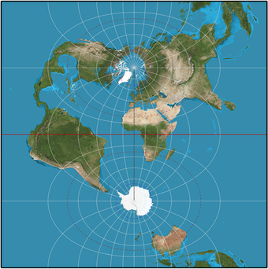
SIRGAS 2000
“The projection is reasonably accurate near the central meridian. Scale at an angular distance of 5° (in longitude) away from the central meridian is less than 0.4% greater than scale at the central meridian, and is about 1.54% at an angular distance of 10°.”

Slide 21
Georeferencing

Slide 22
What is Georeferencing?
Assignment of real world coordinates to pixels of an unreferenced raster
Deccan Traps example from last time
Requires manually fixing “control points” between map and real spatial objects
BEST CONTROL POINTS:
Riverheads
Clear topographic features (ridge, unique landform, etc.)
Intersections of lat/long grid lines
Edge of map area
BAD CONTROL POINTS: Town names
Choice of transformation….
Thorough walk through: https://www.qgistutorials.com/en/docs/3/georeferencing_basics.html

Slide 23
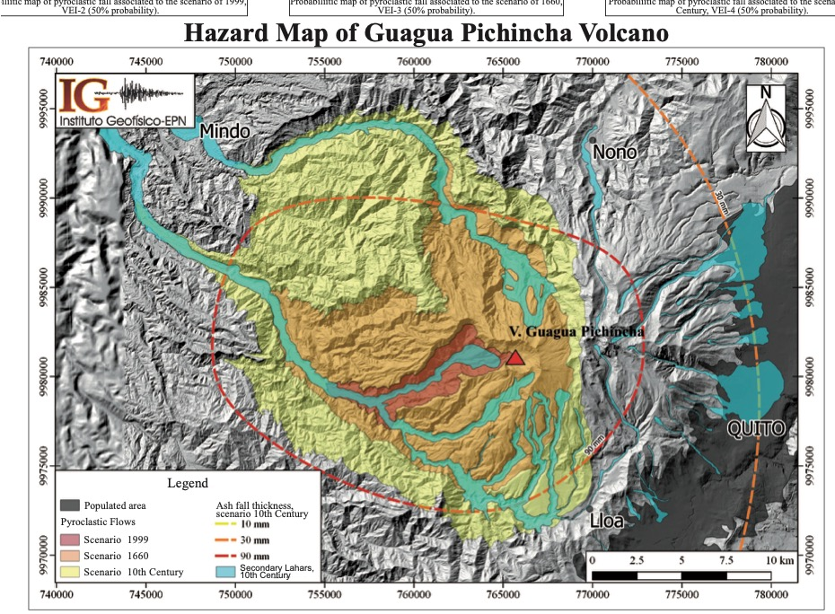

Slide 24
Tracing Basemap

Slide 25
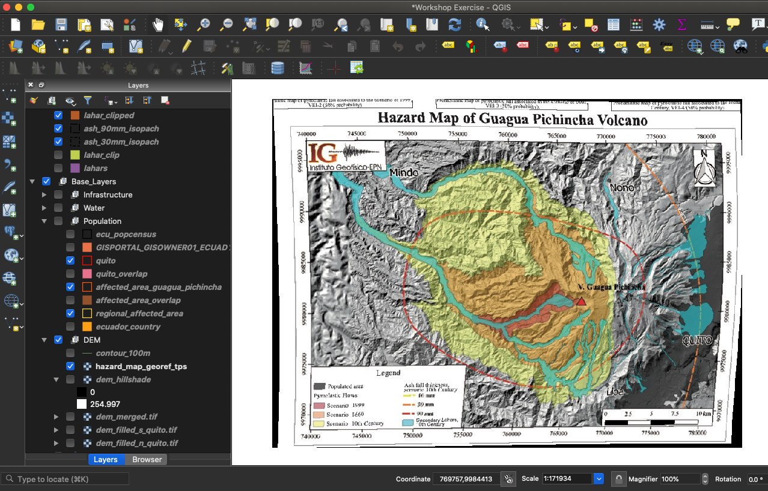
Creating New Features
Need to first define layer, then manually add points
Note: image processing algorithm can do some of this work
NEXT account for tracing errors: I fixed my scale of tracing, so I know my error is between 10-50 m (USGS)
ALWAYS KEEP SCALE IN MINDS
We also have to account for distortion from georeferencing

Slide 26
Errors

Slide 27
Error Sources
Attribute data
Unfortunately don’t know this at this time – what is the error in a census?
Hazard Map doesn’t given an indication of error either, but doubtless there is some
Projection error (usually quite small)
Estimated Error of SIRGAS is 1.0m (see EPSG website)
Georeferencing error: Error report suggests < 1 m
However, given we didn’t know starting PCS, this is likely an underestimate – we can see some notable distortion
Anything derived from basemap carries this georeferencing error forward
Base map error: USGS defines between 10-50m error in a map drawn between 1:20000-1:100000 scale
We drew between these scales, so let's take the high end (50 m)

Slide 28
Analysis

Slide 29
Answering our question
How many people are at risk of exposure to the different eruptive products of Guagua Pichincha Quito?
Attribute Manipulation: How many people live in a canton?
Define provinces affected by ash and lahars
Selection, Dissolving
Spatial Statistics: How many people in total?
Exporting Statistics
Areal statistics: % Overlap in Lahars and Quito
Proportion of population vulnerable to lahars

Slide 30
Symbolizing

Slide 31
Making the Data Look Nice
Do some of this formatting before editing the layout
Symbology:
Making topography data look nice
Stylizing vector data
Fill
Stroke
Transparency
Label Making
Easy Custom Labels + Memory

Slide 32
Layout Management

Slide 33
Layout
Elements we want:
Main Map
Regional Inset Map
Legend
North Arrow
Scale bar
Grid
Labels for important features
Text box summarizing findings
Thigs to keep in mind:
Map Scale
Locking of display
Legend items
Aesthetic value

Slide 34
Thoughts for next time

